Slide 1







Automated Temperature-based Fan Speed Control using Arduino
EEE 428: Measurement and Instrumentation Laboratory
Final Project Demonstration
Submitted by
Md. Saklain Morshed
1606143
Md. Saheed Ullah
1606152
Zulqarnain Bin Ashraf
1606153
Md. Abrar Istiak
1606155
Rafid Umayer Murshed
1606186

Slide 2
Outline
Background
Bill of Materials
Methods
Interfacing LM35
LM35 Temperature Reading
Algorithm
Circuit Diagram
Source Codes
Simulation
Experimental Demonstration
Photo Gallery
Future Outlook
Difficulties
Conclusion
References

Slide 3
Motivation
People waste lots of energy by leaving switches on even when not necessary.
Most of the Fan’s Operational Life becomes shorter because of spinning at maximum speed all the time.
We need to alter the fan speed regularly during the spring season, but manually managing it is inconvenient.
And a project like this has the potential to solve all of the aforementioned issues.

Slide 4
Bill of Materials
Components Name | Description | Quantity | Price(BDT)
Arduino Board | Arduino UNO R3 Development Board | 1 | 400
Temperature Sensor | LM35 Analog Temperature Sensor | 1 | 35
Fan | 12V DC Fan | 1 | 70
LCD Display | JHD162A 16x2 LCD Display | 1 | 169
Transistor | IRFZ44N Mosfet | 1 | 20
Resistors | .1K,1K,4K,10K | 4-6 | 10
Diode | 1N4007 | 1 | 5
Capacitor | 10uF electrolytic capacitor | 1 | 15
Buzzer | Piezoelectric Buzzer | 1 | 40
Power Supply | Duracell 9V dc battery | 1 | 70

Slide 5
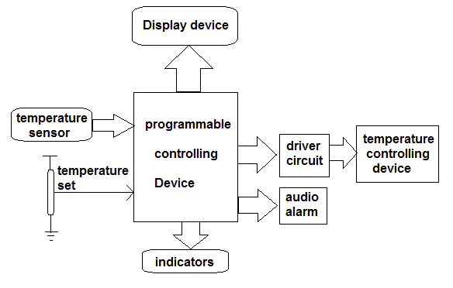
Methods
Block Diagram for Automated Fan Speed Control

Slide 6
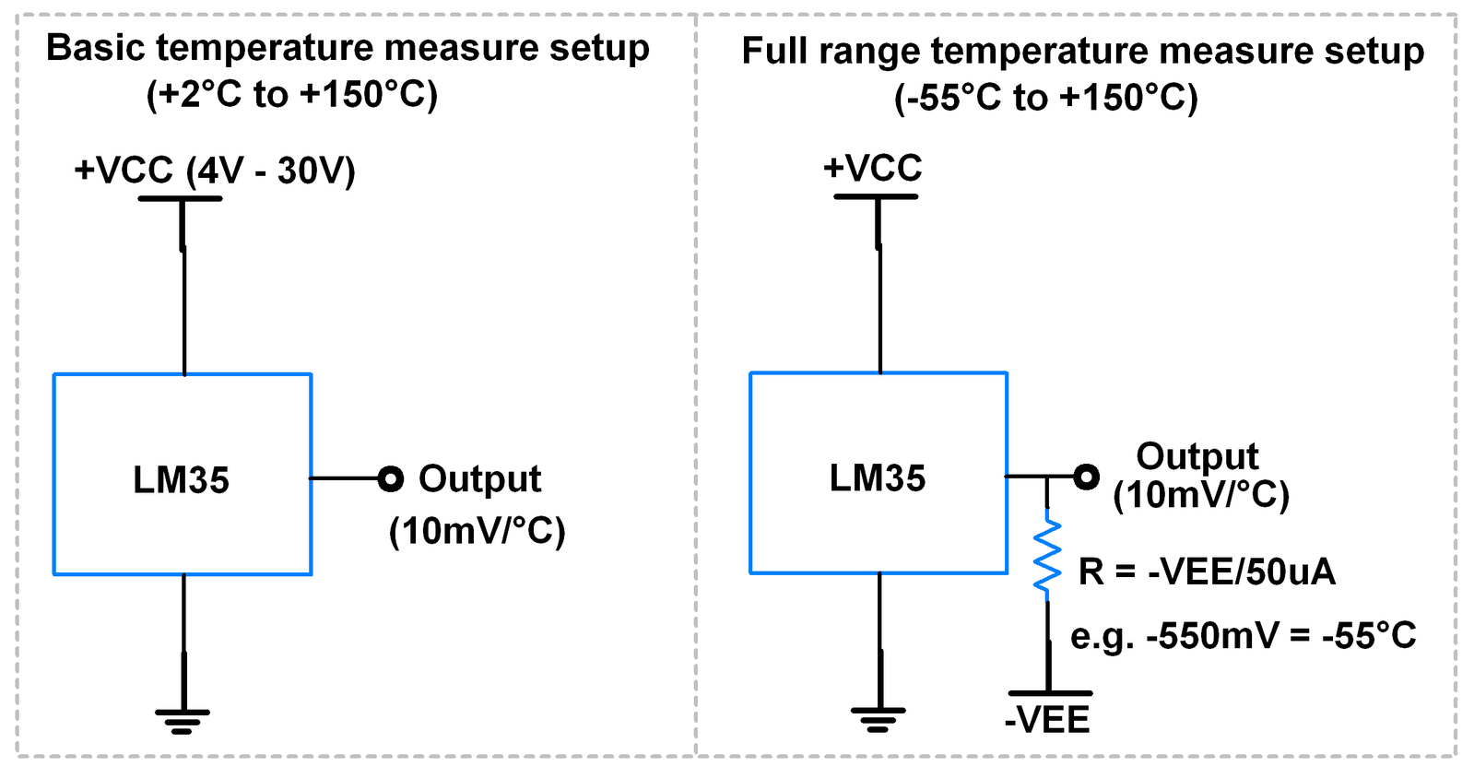
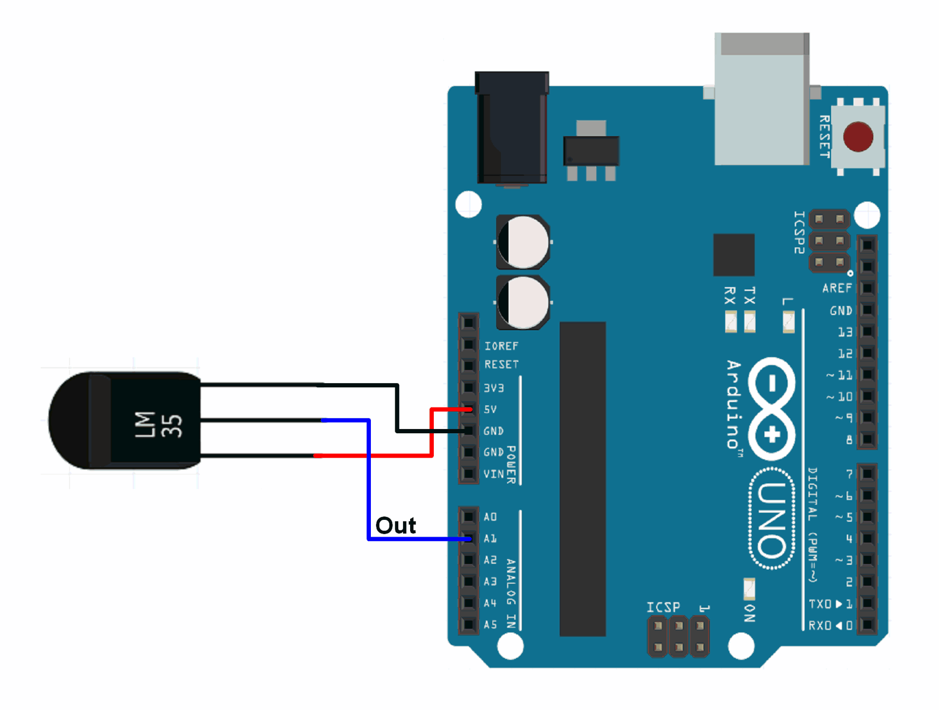
Interfacing LM35

Slide 7
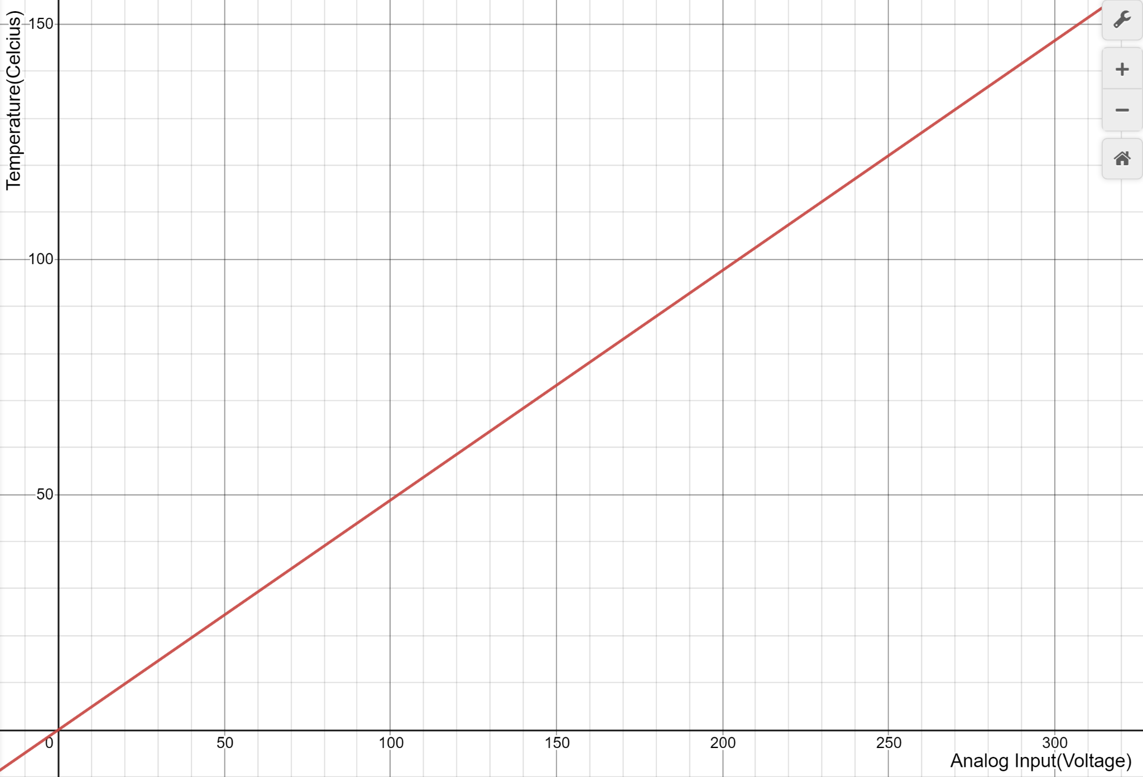
LM35 Temperature Reading
We are using it in the basic temperature measure setup.
Range of temperature that can be measured is (+2 C to +150 C)
The sensitivity of LM35 is 10 mV/degree Celsius. As temperature increases,
output voltage also increases.
E.g. 250 mV means 25°C.
The arduino analog input maps (0V to 5V) into (0 to 1023)
At a temperature of 150C, LM35 will generate 1500 mV or 1.5V
Arduino analog Pin read 1.5V as (1.5 x 1023 / 5) or 306.9.
Similarly +2 C will be read as 4.092
Any temperature in between +2 C and +150 C can be measured using this calibration curve with slope = 0.48828125

Slide 8
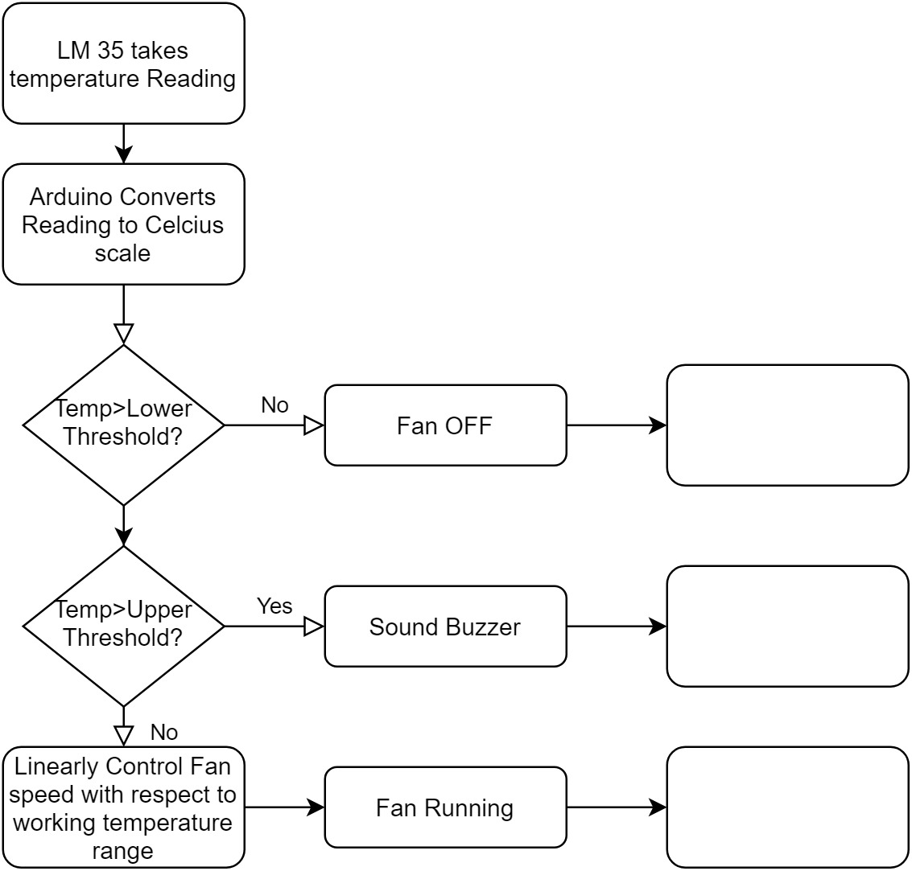
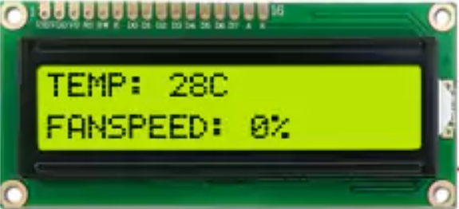
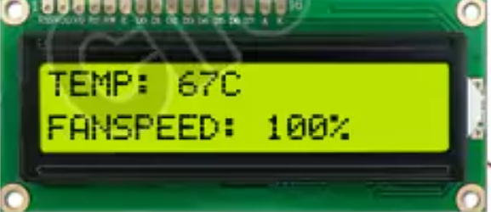
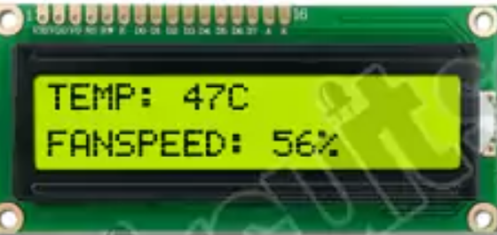
Algorithm

Slide 9
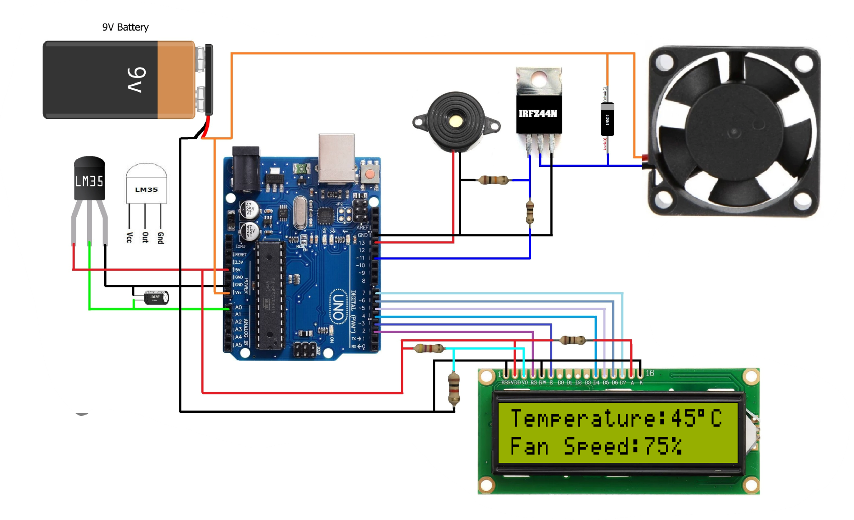
Circuit Diagram

Slide 10
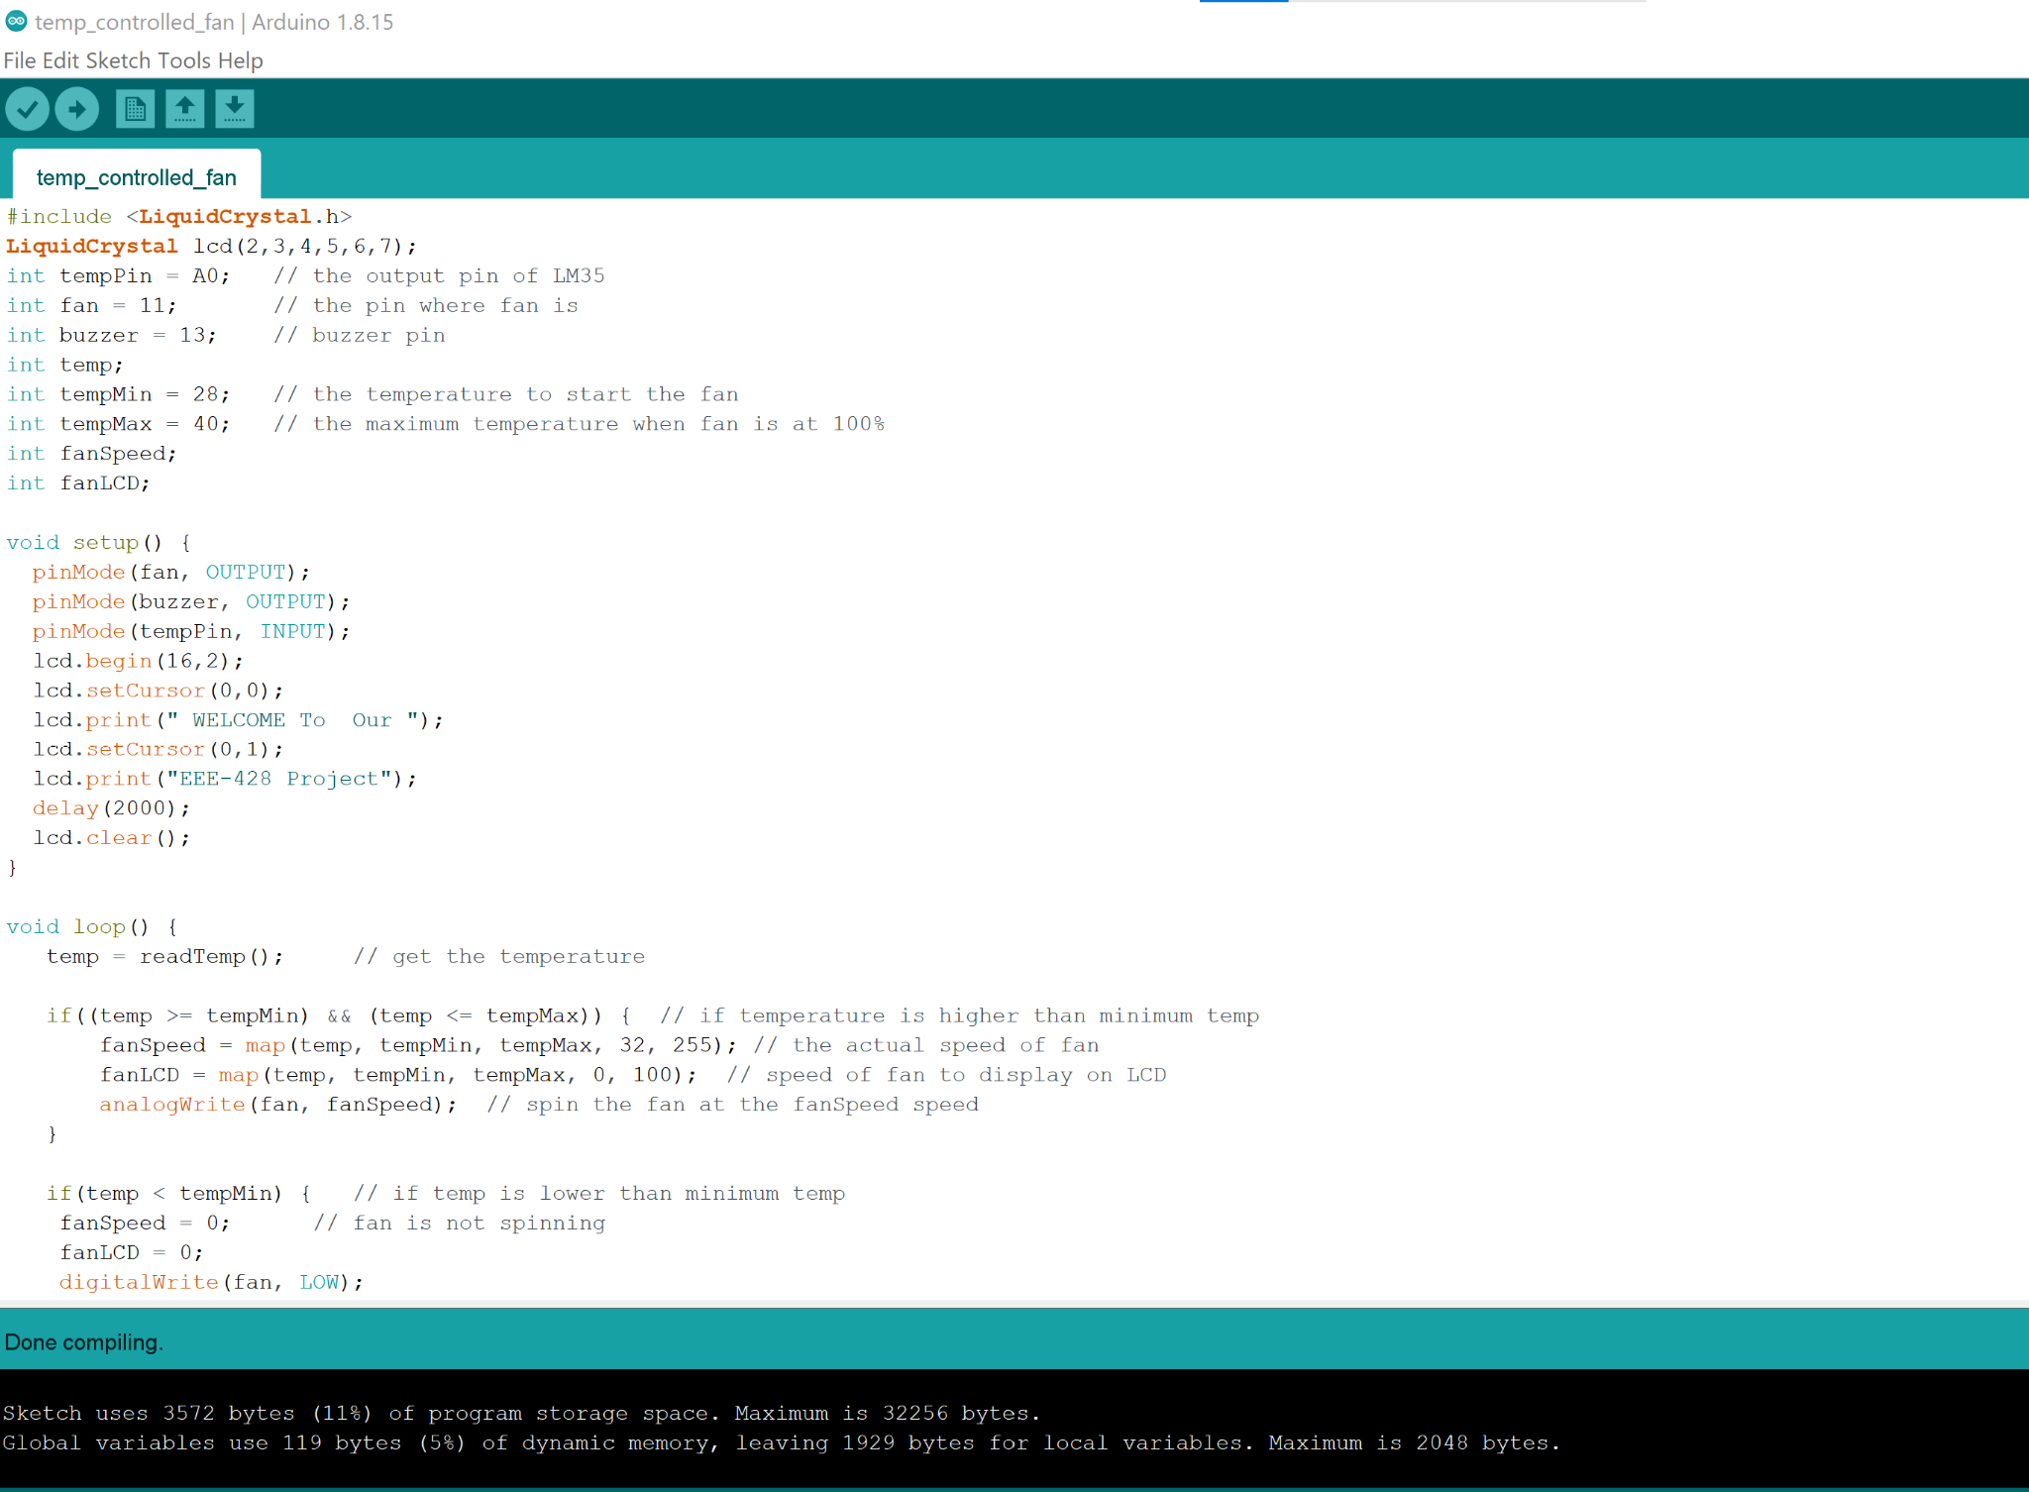
Source Codes

Slide 11
Source Codes Sections
1. Introducing Pin Number of Arduino
2. Converting Temp. into Celsius Scale
3. Welcome to Our EEE-428 Project Displaying
4. Mapping Fan Speed with Temp. Reading
5. Decision Taking for Extreme Case
6. Displaying Temp. & Fan Speed in 16*2 Display

Slide 12
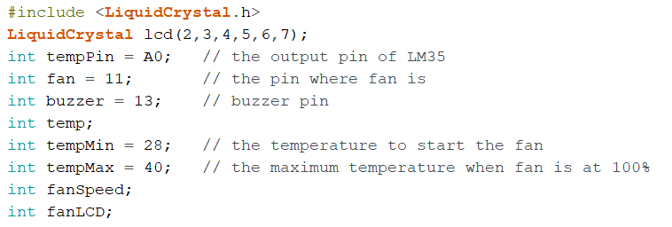
Introducing Pin Number of Arduino

Slide 13
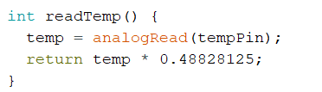
Converting Temp. into Celsius Scale
The sensitivity of LM35 is 10 mV/degree Celsius. As temperature increases,
output voltage also increases.
Any temperature in between +2 C and +150 C can be measured using this calibration curve with slope = 0.48828125

Slide 14
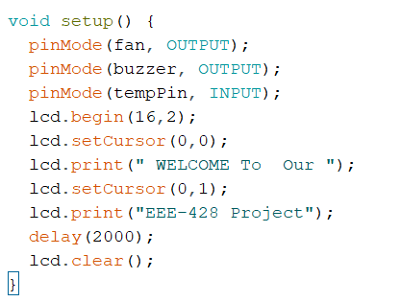
Welcome to Our EEE-428 Project Displaying

Slide 15
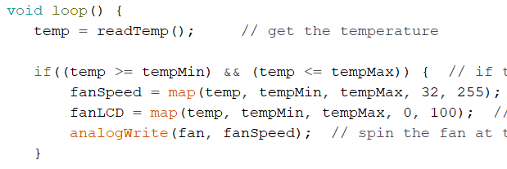
Mapping Fan Speed with Temp. Reading

Slide 16
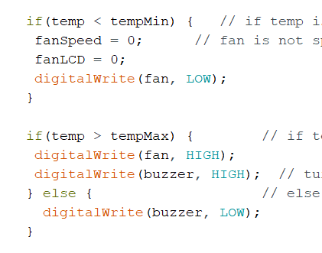
Decision Taking for Extreme Case

Slide 17
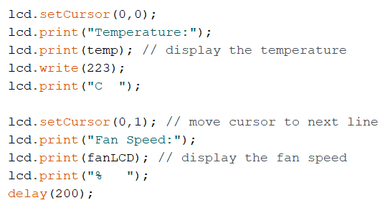
Displaying Temp. & Fan Speed in 16*2 Display

Slide 18
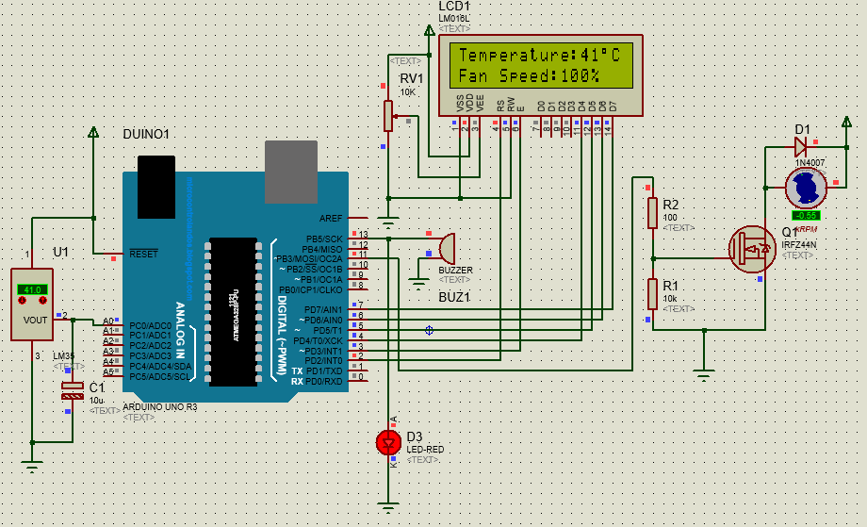
Simulation

Slide 19

Experimental Demonstration

Slide 20
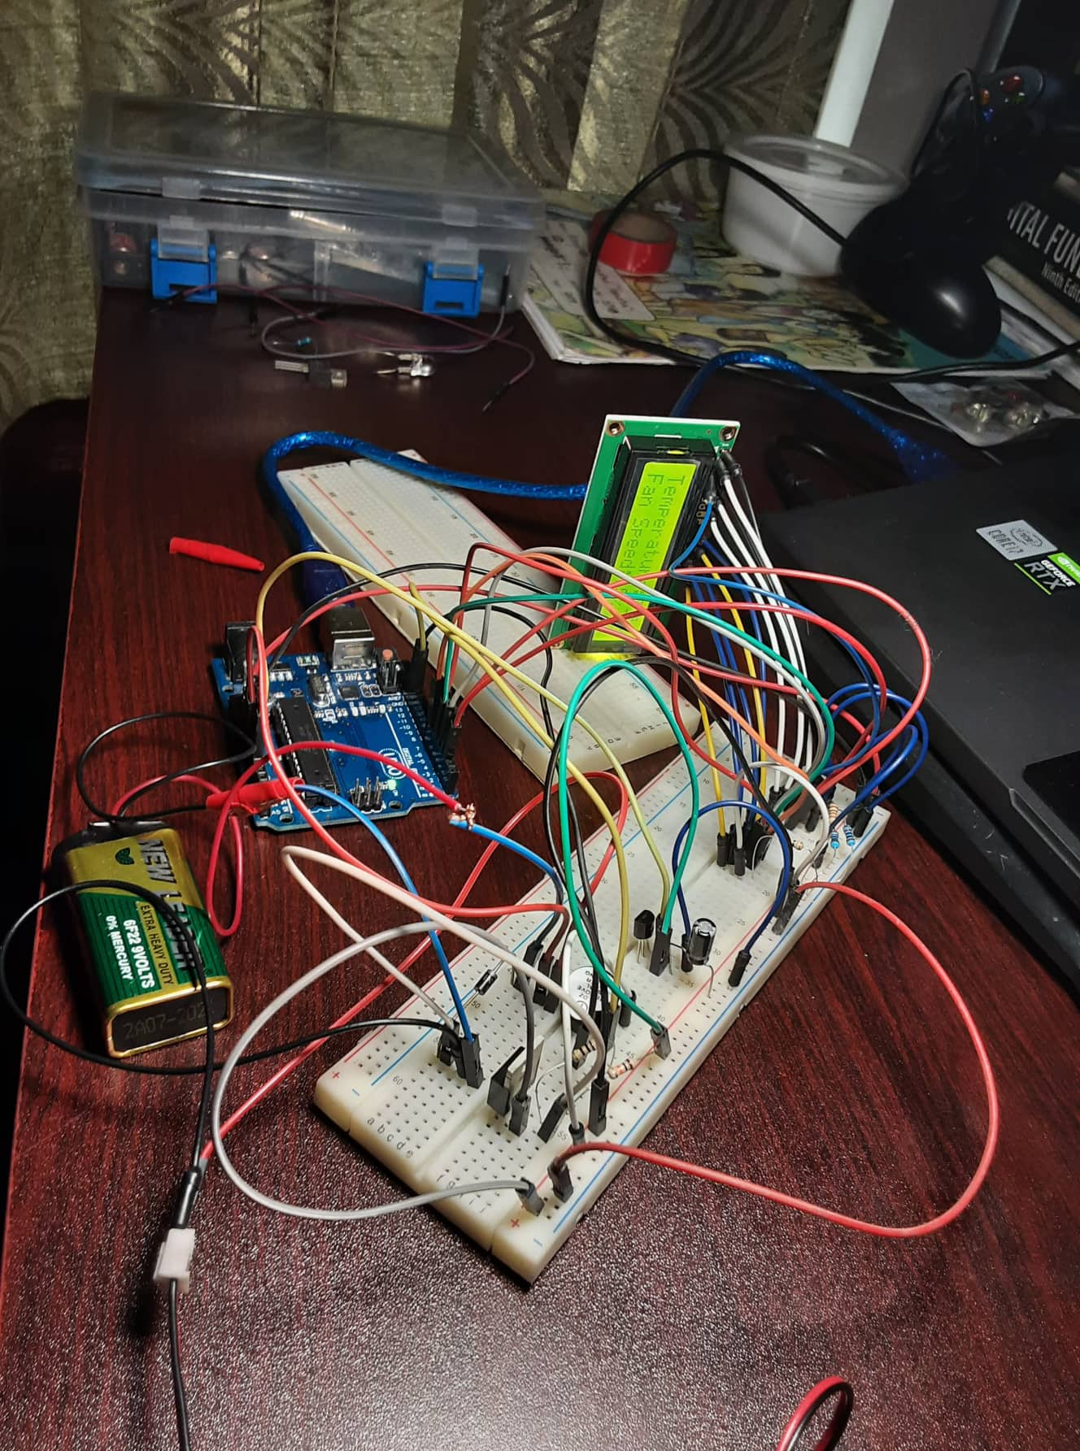
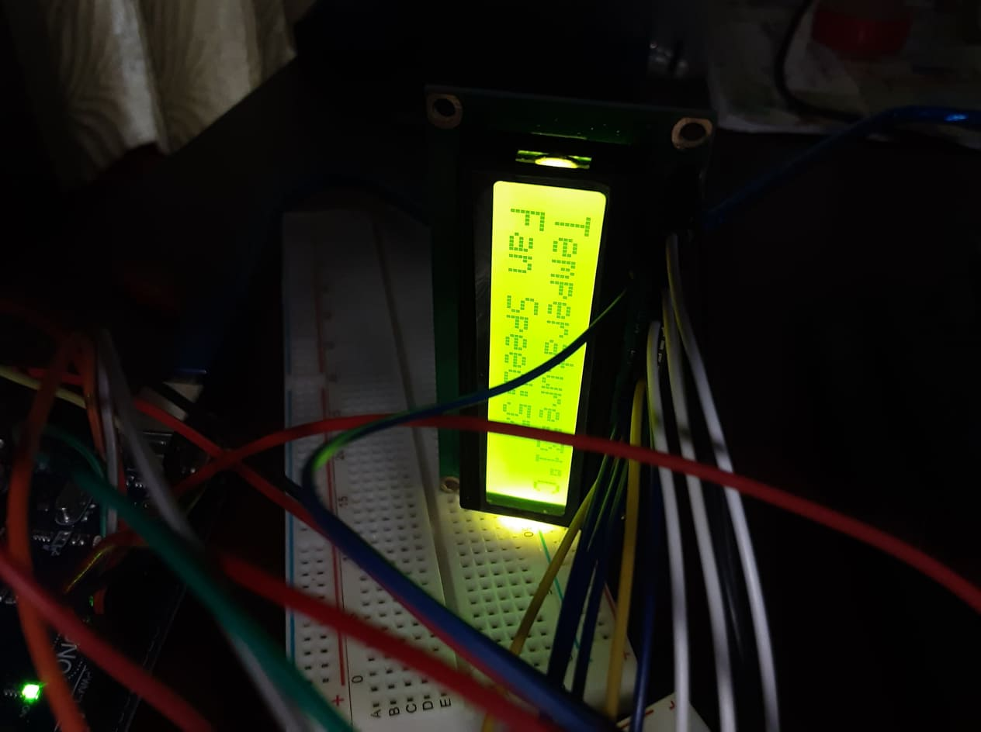
Photo Gallery

Slide 21
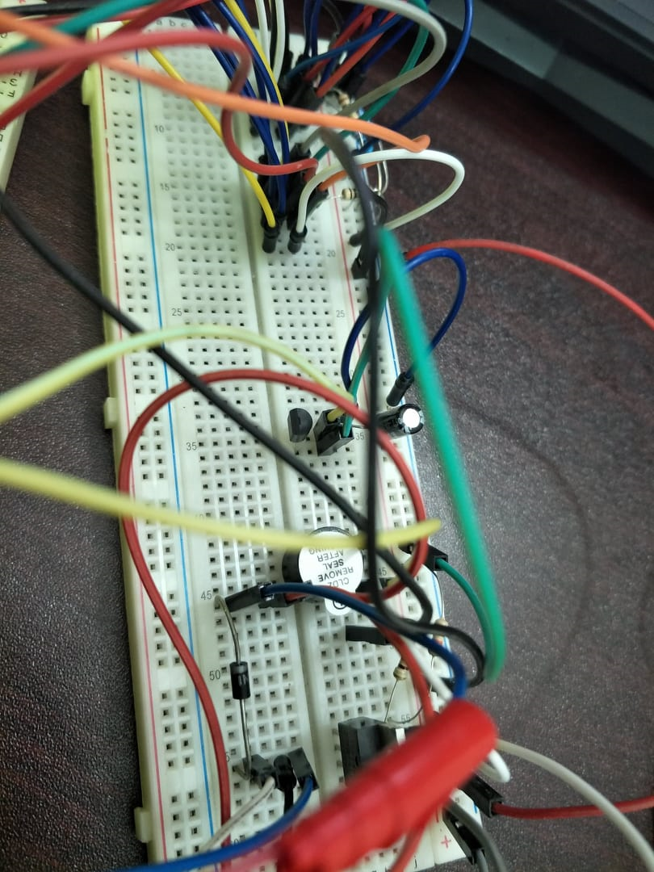
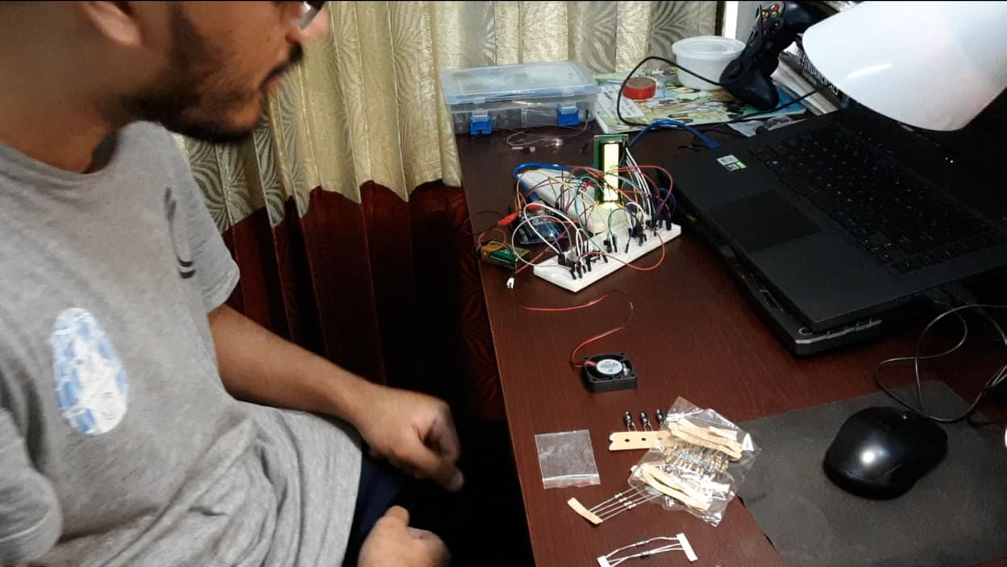
Photo Gallery(Continued)

Slide 22

Future Outlook
This project can be exploited in home automation.
ML model can be used to find the optimum low and high temp for a specific field of application.
Can be introduced in smart grid.
Can be used for fire alarm system.
Other types of sensor such as pressure, light etc. can be used to control other appliance such as bulb,LED,Oven, Washing machine etc. using the same setup.

Slide 23

Difficulties
Covid situation implied some difficulties in
implementing this project.
LCD soldering was not possible due to lockdown restrictions.
Testing the setup was quite difficult due to lack of appropriate equipments at home.
No laboratory facilities could be used due to
lockdown restrictions.

Slide 24
Advantages
This project can be used in Home and Industry.
This will help in saving the energy / electricity.
To monitor the environments that is not comfortable, or not possible for humans to monitor, especially for extended periods of time.
To assist disabled people to adjust the fan speed
automatically.

Slide 25
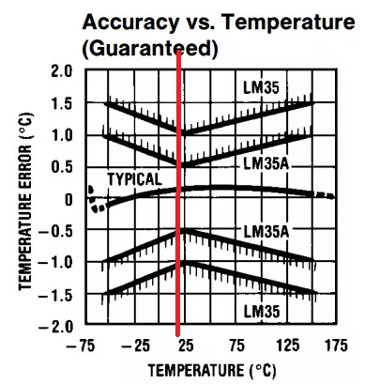
Disadvantages
It can only be maintained by technical person. Thus, it becomes difficult
to be maintained.
Due to temperature variation, after some time its efficiency
may decrease.
LM35 sensor isn’t extremely accurate,
and it may show some discrepancy in different
circumstances.

Slide 26
References
LM35
LM35 Interfacing with Arduino

